Slide 1

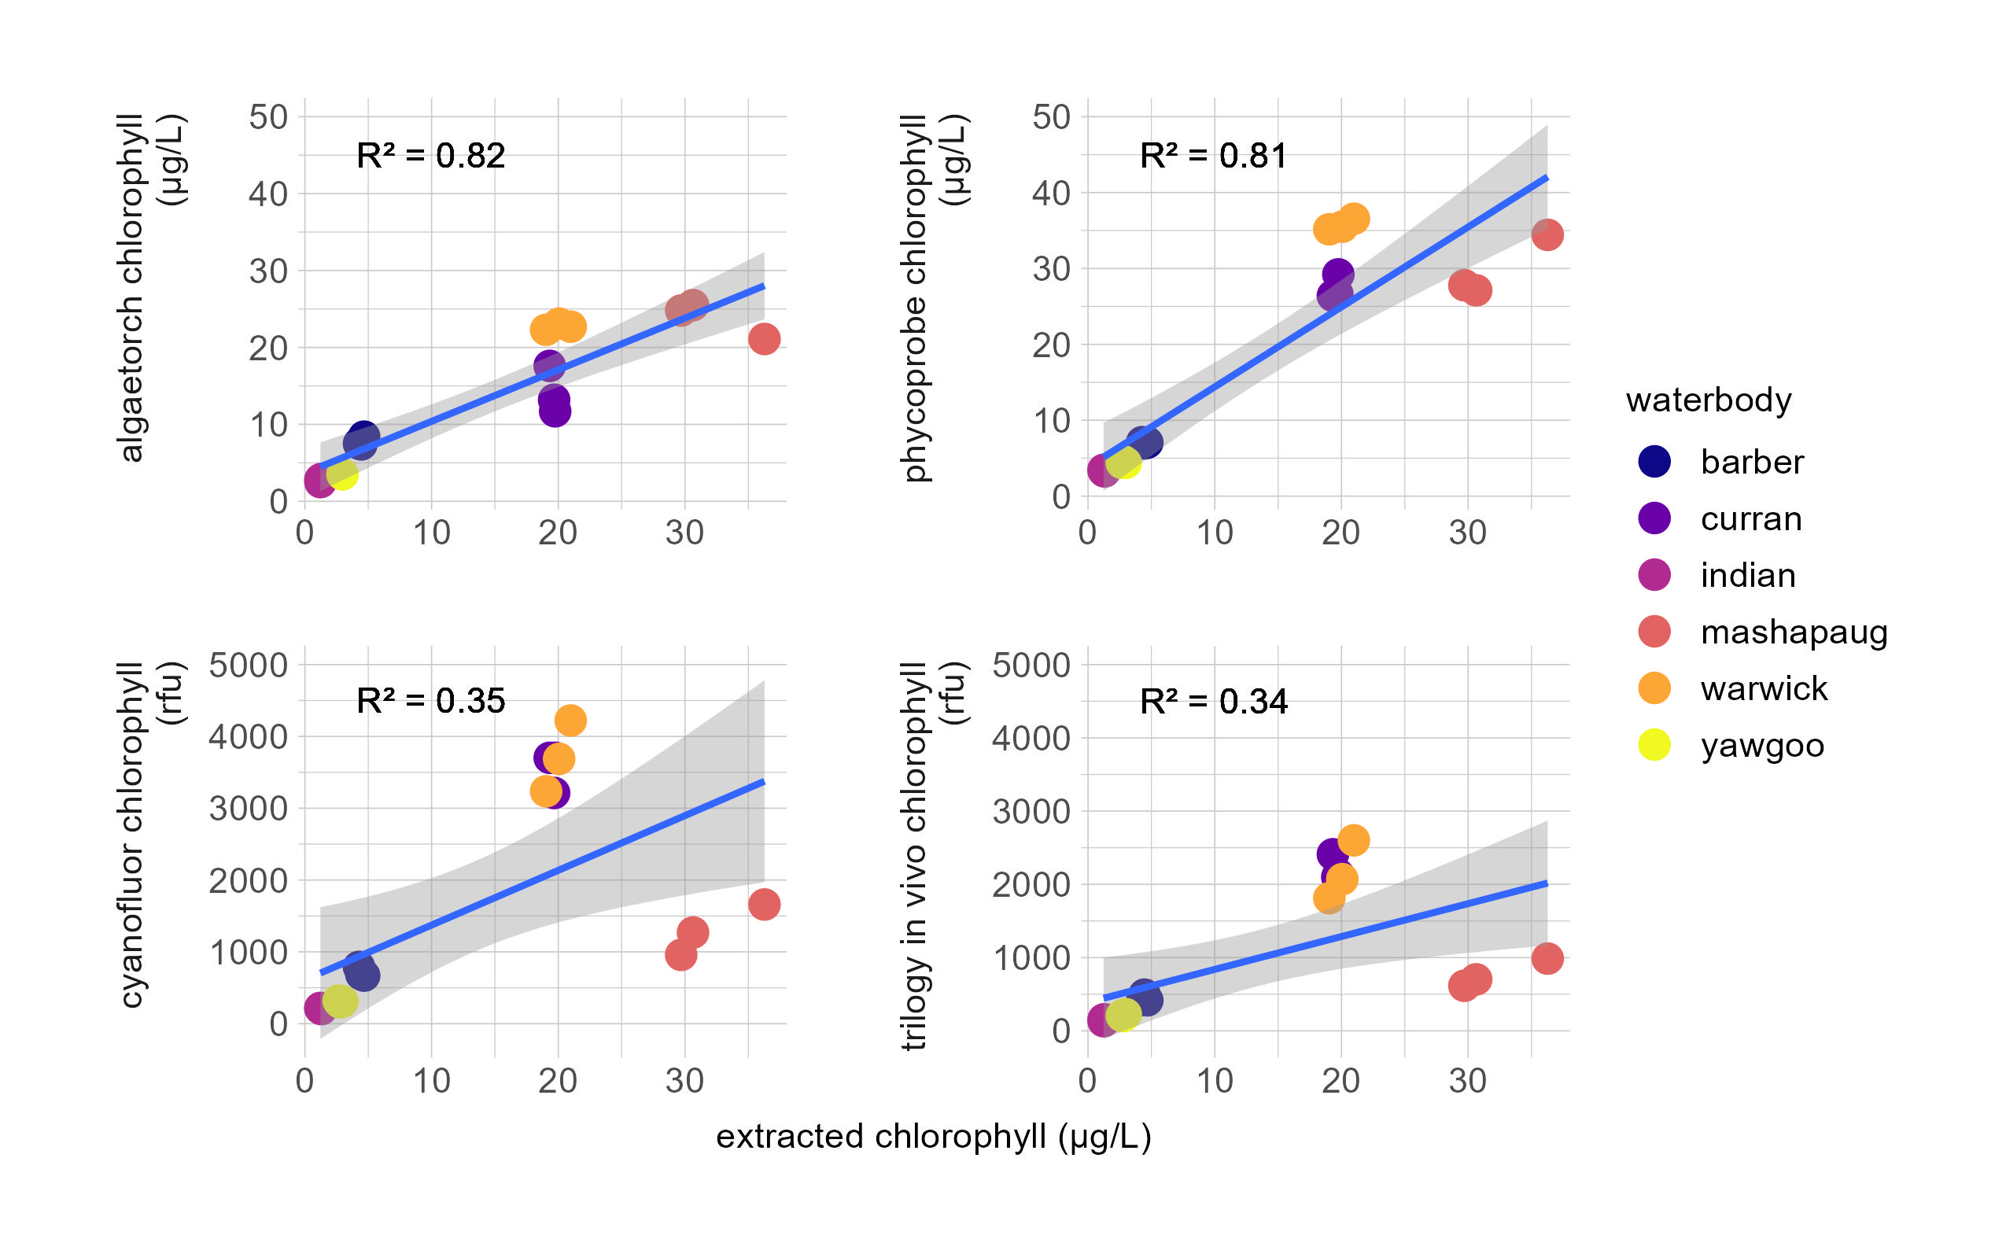
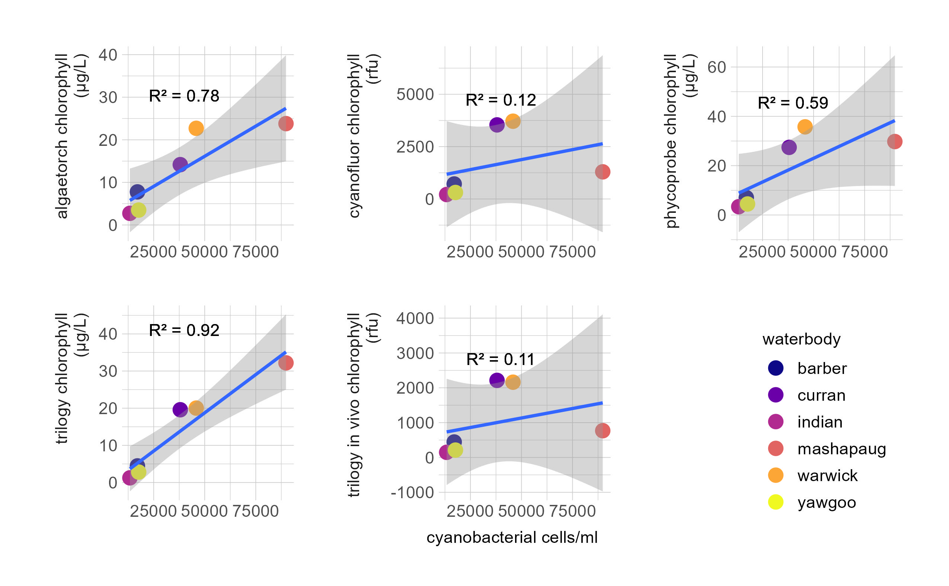
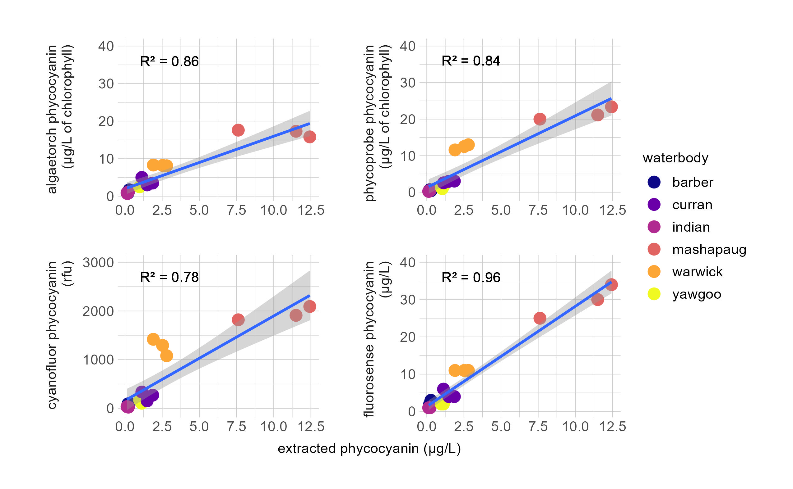
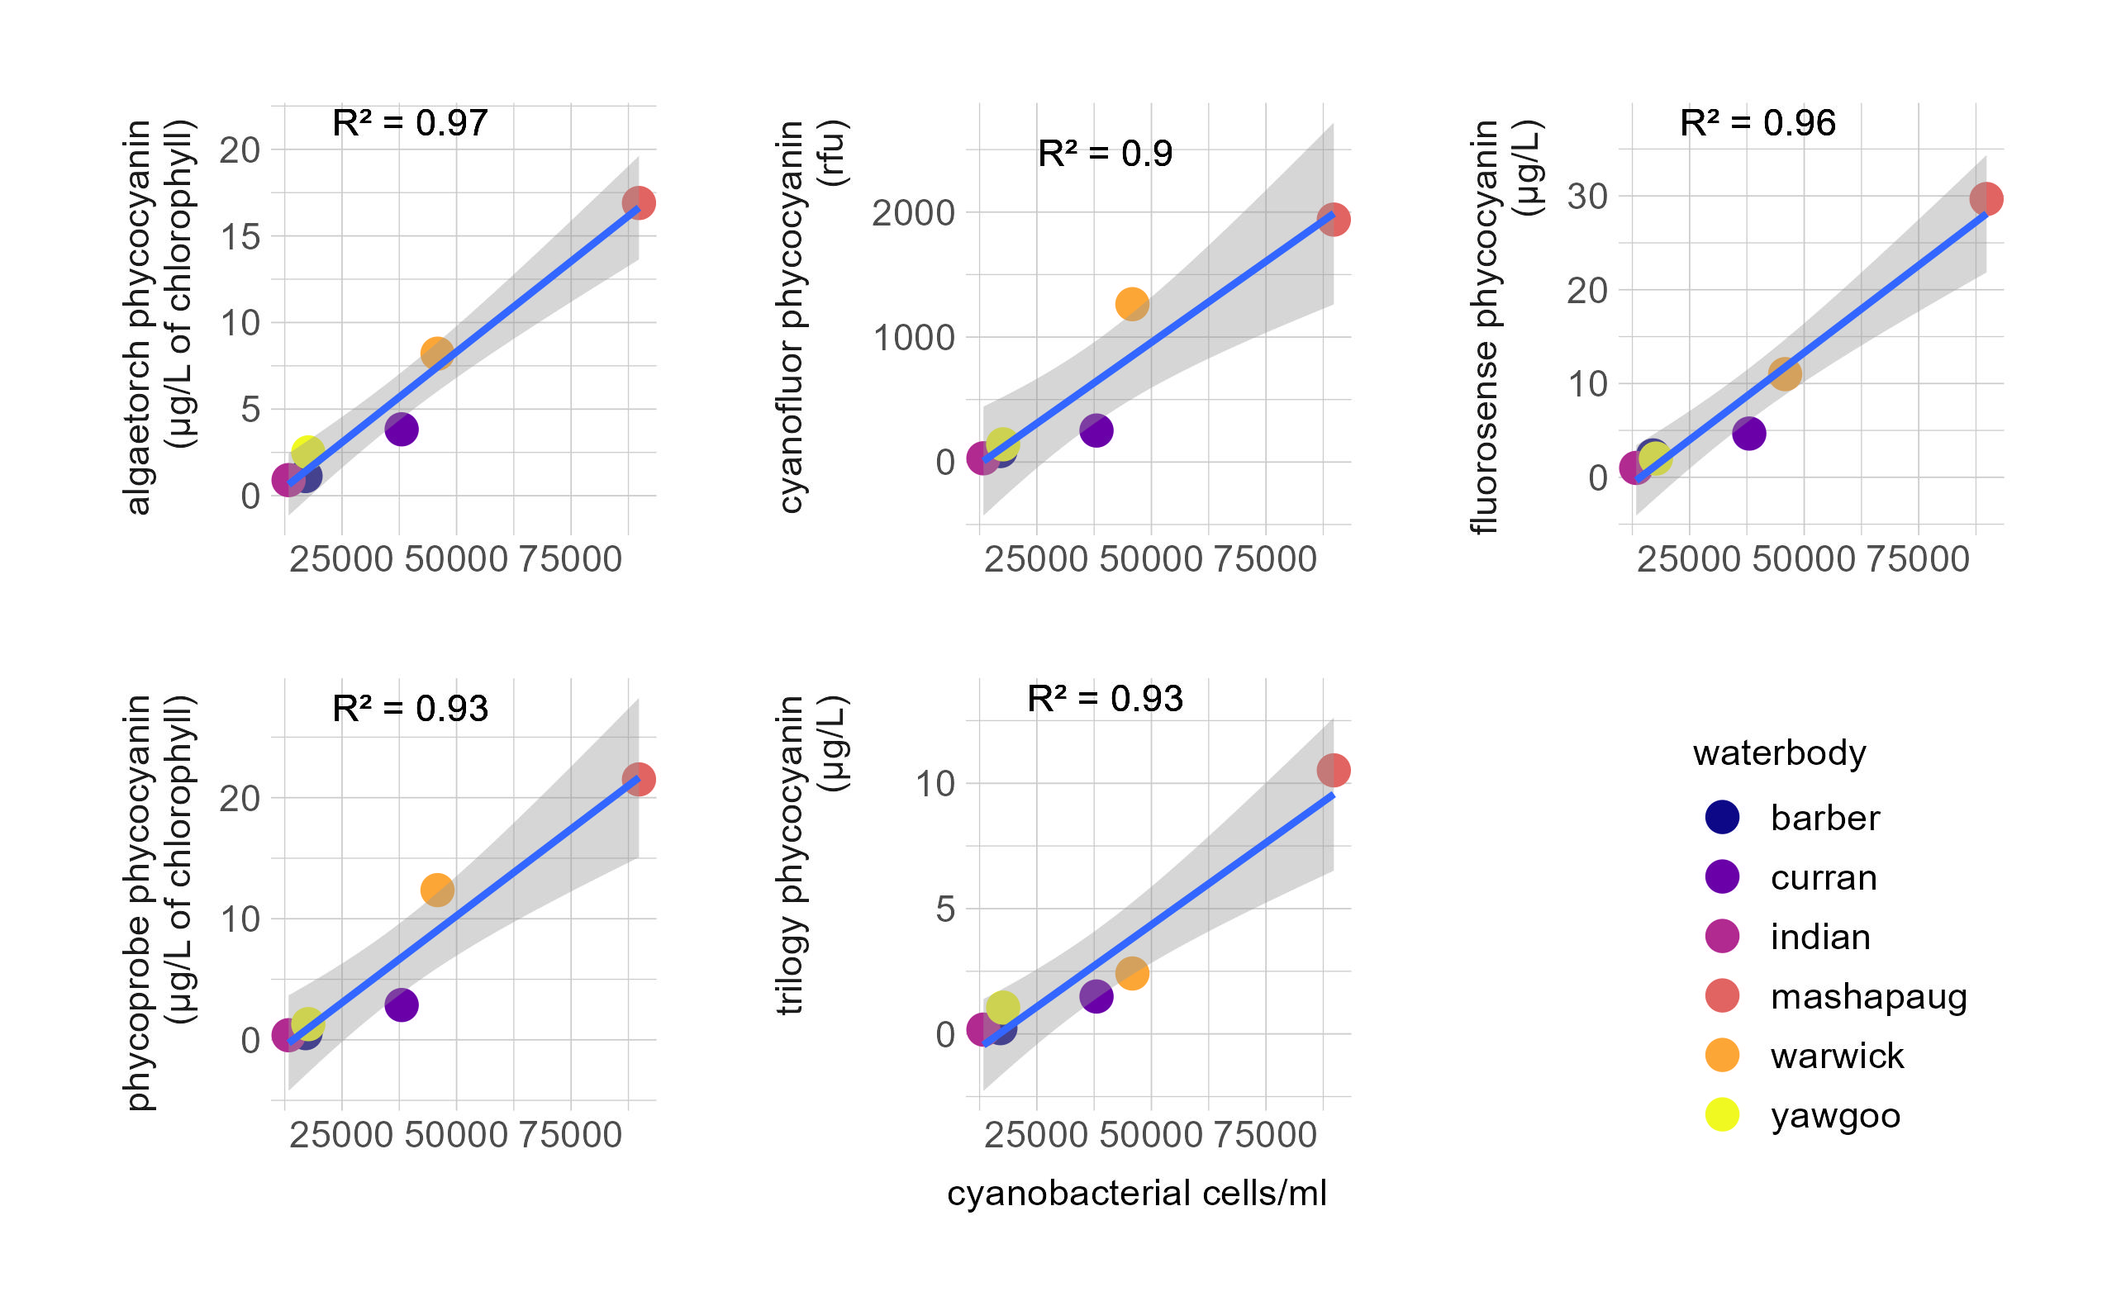
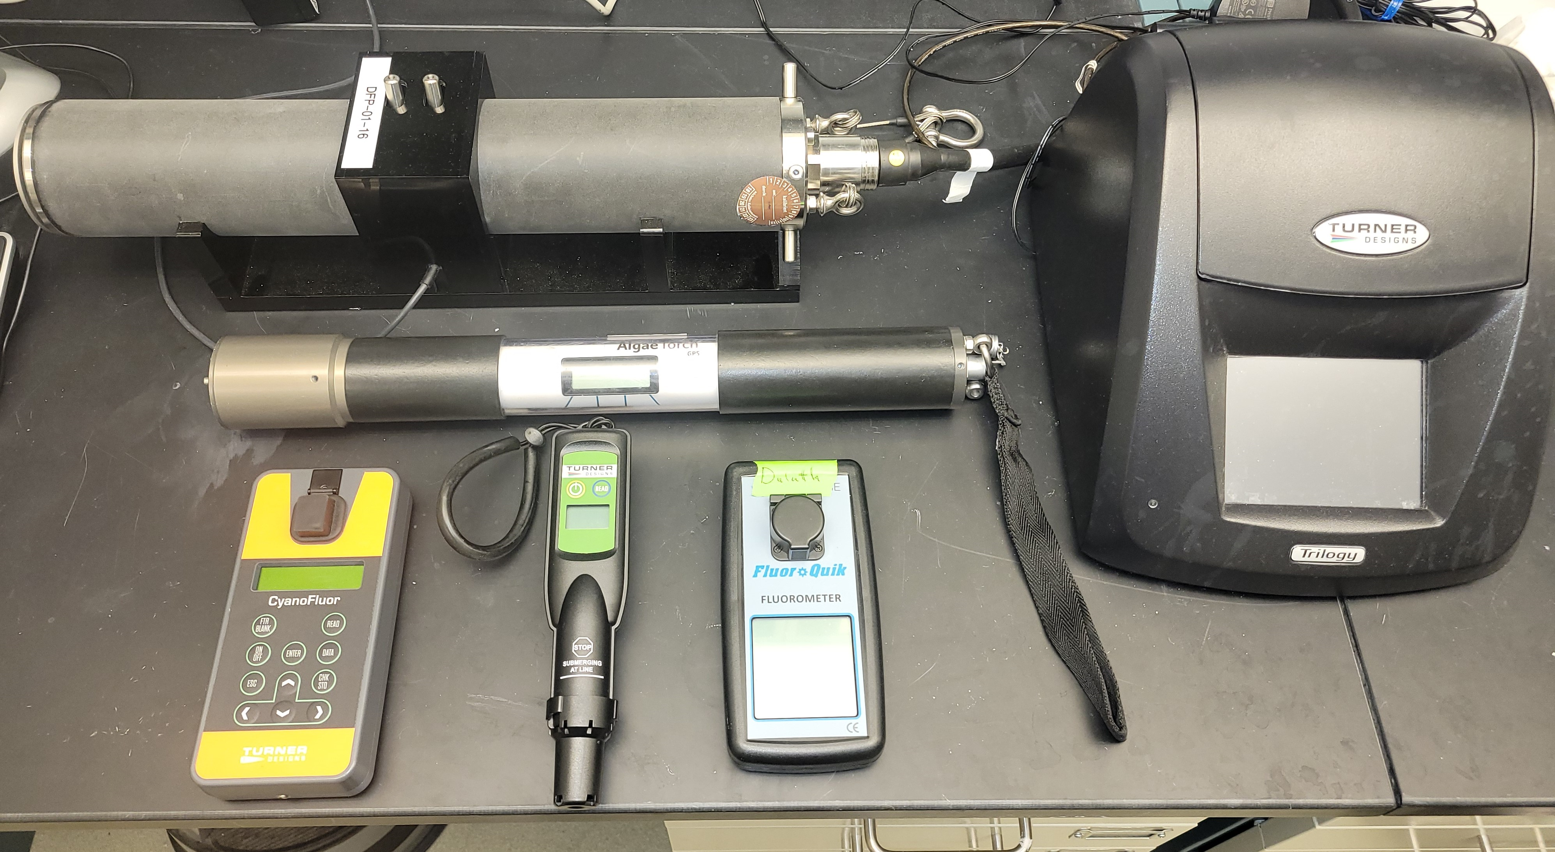
Comparing fluorometric methods (in-vivo vs extracted) for cyanoHAB monitoring in six Rhode Island ponds
Jakob Stankoski¹, Stephen Shivers², Jeff Hollister², Sophie Fournier³, and Betty Kreakie²
¹ORAU Atlantic Coastal Environmental Sciences Division, Narragansett, RI, 02882
²USEPA Atlantic Coastal Environmental Sciences Division, Narragansett, RI, 02882
³Unaffiliated (Former ORAU ACESD)
²
Harmful algal blooms caused by cyanobacteria (cyanoHABs) are detrimental to human and environmental health and can be difficult to monitor without specialized training and equipment. A variety of instruments have been developed to measure cyanoHAB indicators (i.e., chlorophyll a or phycocyanin) that do not require an extraction process. We compared measurements from five in-vivo fluorometers (Turner Trilogy in-vivo module, Turner Fluorosense, Turner Cyanofluor, bbe AlgaeTorch, and bbe Phycoprobe) to results from solvent-based extractions for chlorophyll a and phycocyanin at six different waterbodies in Rhode Island. In-vivo measurements of chlorophyll a were not consistently correlated with the extracted results (r² between 0.34 and 0.82). Some variability in the chlorophyll a results can be explained by differences in the phytoplankton community at the different sampling locations. We found a strong relationship between extracted phycocyanin and in-vivo fluorometers (r² ranging from 0.78-0.96). Phycocyanin results from in-vivo fluorometry were also strongly correlated with cell counts, which implies that phycocyanin measurements from these instruments can be a good proxy for cell counts. Many federal, state, and local entities use cell counts of cyanobacteria to determine when to issue health or contact advisories for waterbodies. Producing accurate cell counts requires highly specialized training/equipment, processing time, and counts can vary greatly between technicians. The results from this study encourage further research using in-vivo fluorometry and continued discussion of moving away from cell counts and to fluorometric based measurements, in particular phycocyanin, for making public health decisions regarding cyanoHABs.
Abstract
Introduction
Harmful algal blooms caused by cyanobacteria (cyanoHABs) impact both human and environmental health. CyanoHAB blooms can be difficult to accurately quantify, and monitoring efforts can be expensive and time consuming. Neighborhood and lake associations generally do not have training or equipment for extractive analysis or biovolume cell counts. A variety of instruments have been developed to measure chlorophyll a and/or phycocyanin using in vivo fluorescence without extraction . However, there is multiple sources of error ranging across the instruments that may affect their accuracy and precision. With consideration to these potential problems, these instruments may offer a more time and cost-effective solution to CyanoHAB monitoring.
Discussion
The results of this study indicate that in vivo phycocyanin is better related to extracted phycocyanin when compared to the same measurements for chlorophyll. In addition, phycocyanin from all instruments was better correlated to cell counts than chlorophyll measurements.
Differences in phytoplankton community between study sites caused chlorophyll measurements to be less strongly related with extracted results in certain instruments.
Both extracted chlorophyll and phycocyanin were strongly correlated with cell counts across the study sites.
There was a strong relationship between all fluorometers and phycocyanin. Instruments such as the Fluorosense (only measuring phycocyanin) handled differences in phytoplankton concentrations and community dynamics between the sites.
The results of this study support the use of extracted chlorophyll as an alternative to cell counts in CyanoHAB monitoring.
Currently in vivo chlorophyll a is typically used for routine CyanoHAB monitoring. This study has found that phycocyanin is better correlated with extraction across a variety of instruments.
This study supports the use of in situ phycocyanin measurements for CyanoHAB monitoring of waterbodies. This could specifically be helpful at waterbodies where resources for cell counting, and extractive analysis is not available.
Objectives
How do different handhelds or in situ fluorometers compare to extracted chlorophyll and phycocyanin?
Will the results be comparable at multiple freshwater ponds?
Will in situ/in vivo fluorometric methods be comparable to cell counts and extractive analysis?
Figure 2. Comparison of fluorometers by waterbody
Figure 6. Compare fluorometer chlorophyll to cyanobacteria cell counts
Methods
Five Fluorometers were used during this study: Turner Trilogy (in vivo chlorophyll module), Turner Flurorosense, Turner Cyanofluor, bbe AlgaeTorch, and bbe PhycoProbe . Measurements from these fluorometers were compared with measurements from the solvent-based extraction for chlorophyll and phycocyanin using a Turner Trilogy.
Field samples were collected from eight ponds in Rhode island during October and November 2021. On site after collection, measurements of chlorophyll and phycocyanin were made using the AlgaeTorch and Flurorsense.
Within 24 hours of collection, field samples were analyzed in triplicate using the remainder of the five fluorometers. Samples were also filtered and frozen for solvent based extraction.
Water samples for phytoplankton identification and enumeration were shipped to Phycotech, Inc.
Figure 3. Comparison of phycocyanin measurements by waterbody
Figure 7. Compare fluorometer phycocyanin to cyanobacteria cell counts
Summary of Results
Chlorophyll measurements for all instruments followed the same general pattern as the extracted chlorophyll values (Figure2). The Algaetorch and Phycoprobe measurements exhibited a strong relationship with extracted chlorophyll (R2=.82,.81). The Algaetorch (r2=0.86), Phycoprobe (r2=0.84) , Fluorosense (r2=0.96), and the Cyanofluor (r2=0.78) were all strongly related to extracted phycocyanin. However, the Algaetorch and Phycoprobe are not directly comparable (Figure 3). Extracted chlorophyll a was most strongly correlated with cyanobacterial cell counts (r2=0.92). The Cyanofluor (r2=0.12) and Trilogy in vivo module (r2=0.11) were weakly correlated (Figure 6). Phycocyanin measurements from all instruments were strongly correlated with cell counts (r2 between 0.9 and 0.97)(Figure 7).
The views expressed in this poster are those of the authors and do not necessarily reflect the views or policies of the U.S. Environmental Protection Agency.

